Slide 1
CHAPTER -8
Mining,Blasting and deforestation

Slide 2
MINING
The process of obtaining useful minerals from the earths crust.
A mineral is any natural substance of definite chemical composition and consistent physical properties.
Eg-Gold,silver,diamond,iron ,coal ,etc

Slide 3
ENVIRONMENTAL CONCERNS
Operations and waste products associated with minerals extraction and processing are the principal causes of environmental concerns about mining which may be:
1)Physically disturb landscapes as a result of mine workings ,waste rocks and tailings disposal areas and facility development
2)Increase the acidity of soils
3)Degrade surface and ground water quality
4)Increase airbourne dust and other emissions that could contaminate the atmosphere and surrounding areas

Slide 4
Types of mining
Open pit mining
Surface mining – Placer Mining
Underground mining
Reworking of inactive mines and tailings

Slide 5
1.OPEN PIT MINING
The type of strip mining in which the ore extracts extends very deep in the ground ,necessitating the removal of layer upon layer of overburden and ore
Logging of trees and clear cutting or burning of vegetation above the ore may precede the removal of overburden
(In mining, overburden (also called waste or spoil) is the material that lies above an area that lends itself to economical exploitation, such as the rock, soil, and ecosystem that lies above a coal seam or ore body.)
The use of heavy machinery is the most common means of removing overburden
Open pit involves the removal of natively vegetated areas
So it is the most environmentally destructive type of mining especially within the tropical forests

Slide 6
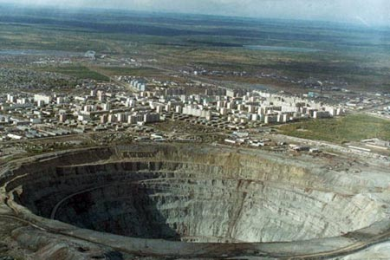

Slide 7
2.Placer mining
Placer means a deposit of gravel(stones) which contains particles of gold deposits.
Is used when the metal of interest is associated with sediment in a stream bed or flood plain
Bulldozers,dredges or hydraulic jets of water(a process called hydraulic mining) are used to extract the ore
It is usually aimed at removing gold from stream sediment and flood plains
As it often occurs within a streambed,it is an environmentally destructive type of mining ,releasing large quantities of sediment that can impact surface water for several miles downstream of the placer mine

Slide 8
3.UNDERGROUND MINING
A minimum amount of overburden is removed to gain access to the ore deposit.
Access to this is gained by tunnels or shafts
Tunnels or shafts lead to a more horizontal network of underground tunnels that directly access the ore.
In the underground mining- the method called stoping or block carving is used.
The above method sections or blocks of rock are removed in a vertical strips that leave a connected underground cavity that is usually filled with cemented aggregate and waste rock
It is less environmentally destructive means of gaining access to an ore deposit
It is more costly and entails greater safety risks than strip mining including open pit mining.

Slide 9
4.REWORKING OF INACTIVE OR ABANDONED AND TAILINGS
Some projects involve reworking of waste piles from inactive or abandoned mines,or older piles at active mines
Typically ,this is proposed when more efficient method of metal beneficiation have made it economical to re-extracts metals from old mining waste.
The material from the piles may be sent to processing facilities onsite or offsite.
Mining projects that only involve the reworking of abandoned mine waste piles avoid environmental impacts of open pit mining and placer mining but stills entail the environmental impacts associated with purification of metals from the waste piles

Slide 10
EFFECTS OF MINING
EFFECTS ON ENVIRONMENT
EFFECTS ON LAND
EFFECT ON WATER
EFFECT ON WILDLIFE

Slide 11
A. EFFECT ON ENVIRONMENT
Rainforest are the biggest source of oxygen, wood and medicine on this earth
Gold is found both in river channels and at the banks of the rivers after flooding.
Hydraulic mining techniques are used for mining gold
The method involves blasting at the banks of the river.
This has irreversible damage to trees ,birds ad animals
While separating the sediment and mercury from the gold yielding gravel deposits, small scale miners may release some mercury into rivers thereby entering into food chain of aquatic animals

Slide 12
b. EFFECT ON LAND
Deforestation
Loss of biodiversity
Pollution

Slide 13
C. EFFECT ON WATER
Pollution
Loss of Aquatic life
Spread of diseases

Slide 14
D. EFFECT ON WILDLIFE
Habitat loss
Habitat Fragmentation-when large areas of land are broken up into smaller and smaller patches,making dispersal by native species from patch to another patch difficult or impossible

Slide 15
BLASTING
Blow up or break up with explosions

Slide 16
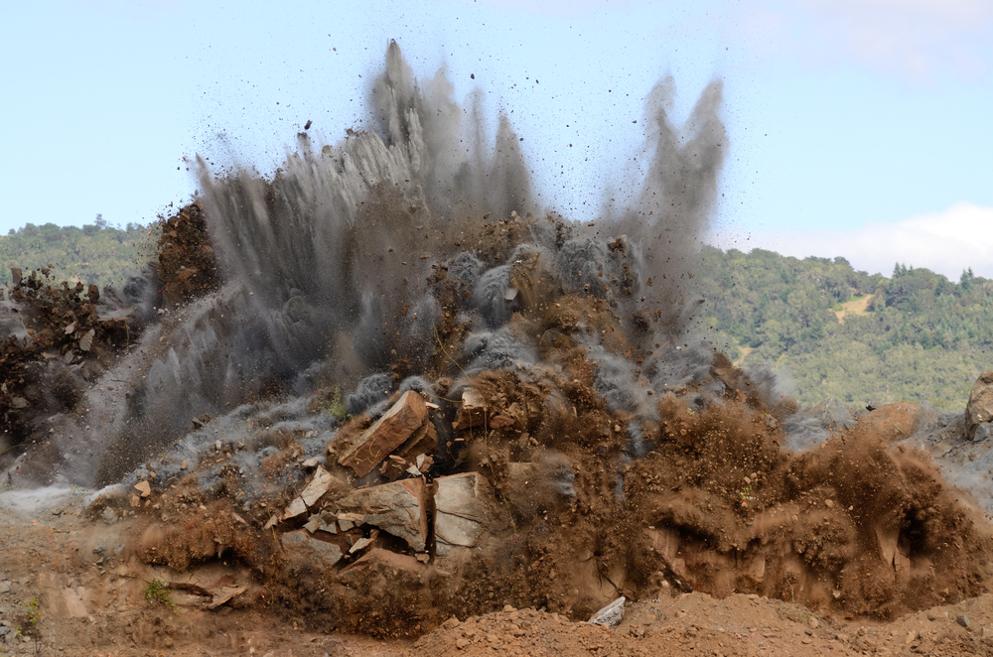


Slide 17
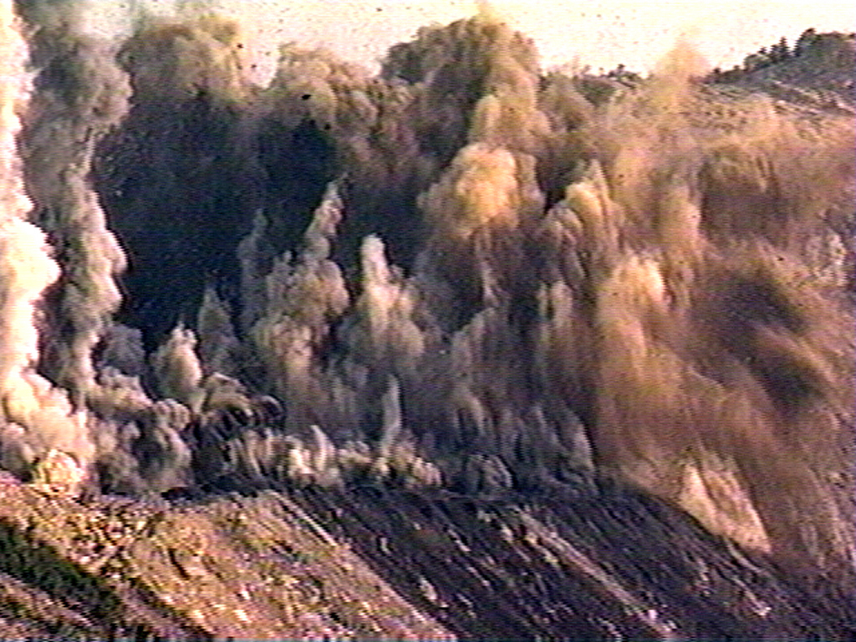

Slide 18
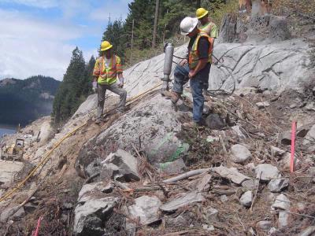

Slide 19
Impact/effect of blasting
1. Environmental effects:
Ground vibration
Air overpressure
Noise
Dust
fly rock
2. Effect on structure:
Cosmetic damage
Minor damage
Major damage
ajaysharma318@yahoo.in

Slide 20
FLYROCK
It is the name given to the fragments of rock propelled into the air by the explosions.
This is clearly potentially dangerous to people and property both inside and outside the site
Therfore should more correctly be thought of as a health and safelty issue rather than an environmental matter.

Slide 21
2.Effect on structures
Cosmetic or threshold damage -The formation of hairline cracks or the growth of existing cracks in plaster,drywall surfaces
Minor damage -the formation of large cracks or loosening and falling of plaster on drywalls surface or cracks through bricks/concrete blocks
Major or structural damage -damage to structural elements of a building

Slide 22
Deforestation
Cutting, clearing and removal of forest
Environmental concern:
  extra flooding and greater drought
  climatic disruption
  soil erosion
  Loss of stability
  Increase CO2
  Loss of biodiversity
ajaysharma318@yahoo.in

Slide 23
Causes of Deforestation
Urban construction
Agriculture
Grazing land (food for animals)
Used for fuel - mining
Commercial purposes - roads
Illegal logging
ajaysharma318@yahoo.in

Slide 24
Effects of Deforestation
Erosion of soil
Disruption of water cycle
Loss of biodiversity
Flooding and drought
Climate changes
Social/cultural effects
ajaysharma318@yahoo.in

Slide 25
Conclusion
More people → more food → more land → more fuel → more homes → more deforestation
ajaysharma318@yahoo.in

Slide 26
DEFORESTATION FACTS:
140000 acres of tropical forests are destroyed each day
10:1 is the ratio of deforestation to reforestation
It will take 177 years to clear all tropical rain forests if the present deforestation rate is continued
Less than 5% of the world’s tropical rain forests are in parks and reserves

Slide 27
Any question
ajaysharma318@yahoo.in

